Slide 1



Energy
An Introduction to the Energy World, its Production and Consumption
Society of Afghan Architects and Engineers
April 21, 2019
Presenter: Sayed A Azimi

Slide 2
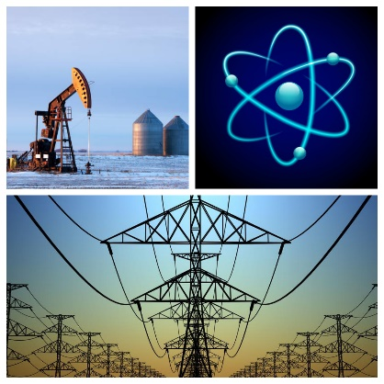
Energy
The topic of energy is very vast and complex. It governs all aspects of the universe and is impossible to discuss it in a single session such as today.

Slide 3

Definition. Energy is defined as “The ability or power to do work (sustained physical or mental activity)”.
Modern civilization is possible because people have learned how to change energy from one form to another and then use it to do work. We use energy to move cars along roads and airplane through air, to cook food on stoves, to make ice in freezers, and to light our homes.
What is Energy?

Slide 4
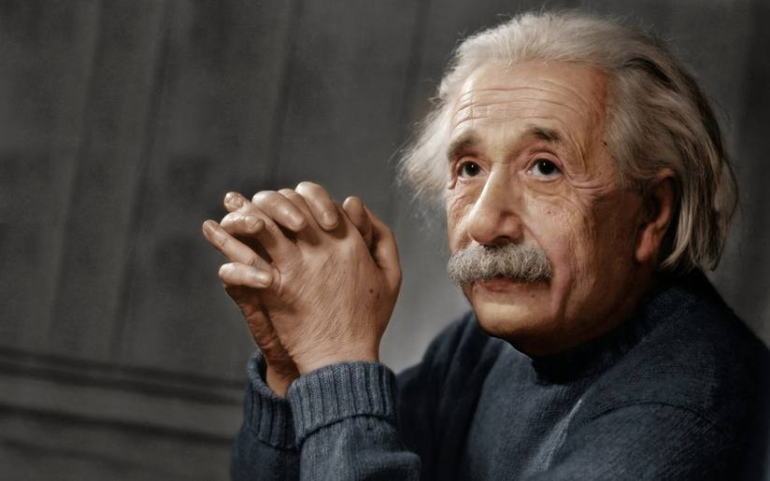
The famous physicist of the twentieth century Albert Einstein in 1905 proved the paradox of mass–energy equivalence which states that anything having a mass has an equivalent amount of energy and vice versa. He proved this relation by his famous formula:
E = mC²
This formula or relation makes the conversion of units of mass to units of energy (and vice versa) possible, no matter what system of measurement units is used.
Mass-Energy Equivalent

Slide 5
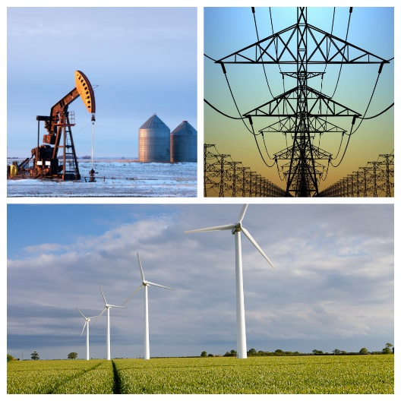
The Governing Laws of Energy
In physics, energy is the quantitative property that must be transferred to an object in order to perform work on, or to heat the object.
Energy can be neither created nor destroyed but only changed from one form to another.

Slide 6
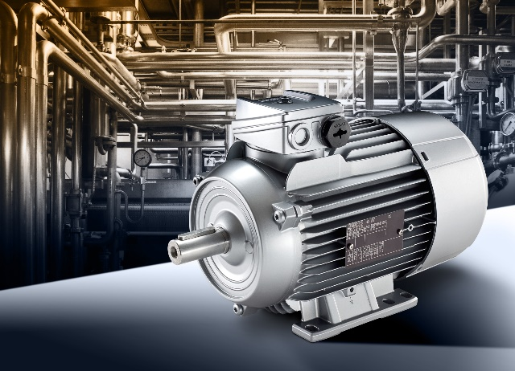
There are two basic forms of energy – Potential and Kinetic
Potential Energy is any type of stored energy. It can be chemical, nuclear, gravitational, or mechanical.
Kinetic Energy is found in movement. An airplane flying or a meteor plummeting each have kinetic energy. Even the tiniest things have kinetic energy, like atoms vibrating when they are hot or when they transmit sound waves. Electricity is the kinetic energy of flowing electrons between atoms.
Forms of Energy

Slide 7
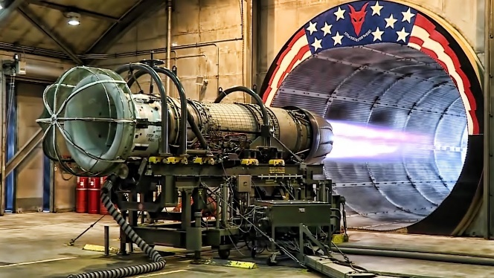
Thermodynamics is the branch of physics concerned with heat and temperature and their relation to energy and work. The behavior of these quantities is governed by the four laws of thermodynamics, irrespective of the composition or specific properties of the material or system in question. The laws of thermodynamics are explained in terms of macroscopic constituents by statistical mechanics. Thermodynamics applies to a wide variety of topics in science and engineering, especially physical chemistry, chemical engineering and mechanical engineering.
For the purpose of today’s conversation, I like to introduce Thermodynamics

Slide 8
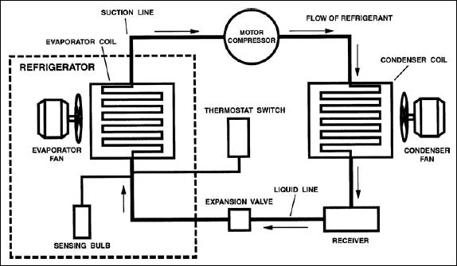
The first law of thermodynamics is a version of the law of conservation of energy, adapted for thermodynamic systems. The law of conservation of energy states that the total energy of an isolated system is constant; energy can be transformed from one form to another, but can be neither created nor destroyed. The first law is often formulated.
Q = U + pV (or Work)
The unit of measurement for enthalpy in different systems are Joules, BTU and calorie; 1BTU = 1,054 Joules and 1BTU = 252 calories.
The First of Law Thermodynamics or Enthalpy

Slide 9
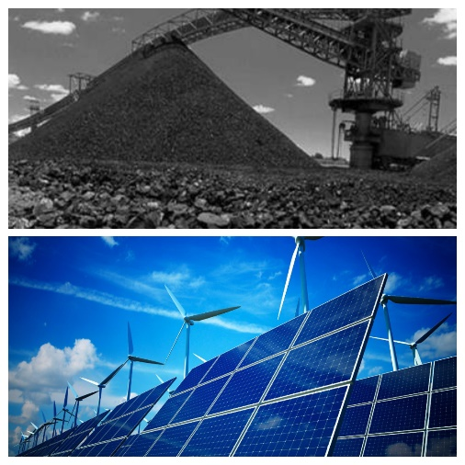
The primary energy sources are classified as renewable or nonrenewable. Renewable and nonrenewable energy can be converted into secondary energy sources such as electricity and hydrogen.
Nonrenewable energy sources are coal, petroleum, natural gas, and uranium are examples of nonrenewable energy sources.
Renewable energy sources include biomass, geothermal energy, hydropower, solar energy, and wind energy. They are called renewable energy sources because they are naturally replenished regularly.
Sources of Energy

Slide 10


Any material that can be made to react with other substances so that it releases energy as heat energy or to be used for work. The concept was originally applied solely to those materials capable of releasing chemical energy but has since also been applied to other sources of heat energy such as nuclear energy (via nuclear fission and nuclear fusion).
What is fuel?

Slide 11
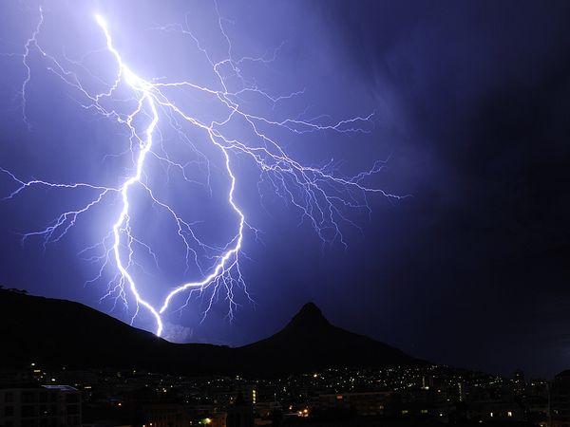

Secondary energy sources are made from other energy sources. They include:
Electricity Is referred to as an energy carrier, which means it can be converted to other forms of energy such as mechanical energy or heat. Primary energy sources are renewable or nonrenewable energy, but the electricity we use is neither renewable nor nonrenewable.
Hydrogen has the highest energy content of any common fuel by weight (about three times more than gasoline), but it has the lowest energy content by volume (about four times less than gasoline.
What are Secondary Energy Sources?

Slide 12
ENERGY IS MEASURED IN JOULES (J), calorie, and Btu
1 Joule (J) is the MKS unit of energy, equal to the force of one Newton acting through one meter.
1 calorie of heat is the amount needed to raise 1 gram of water 1 C
A BTU (British Thermal Unit) is the amount of heat necessary to raise one pound of water by 1 degree Fahrenheit (F).
  BTU= 1,055 Joules
  Calorie = 4.187 Joules
POWER IS MEASURED IN WATTS (W)
  Watt= 1 Joule/second
  746 Watts= 1 Horsepower (hp)
  Watt is the power of a Joule of energy per second
Energy Units
Joule, Calorie, British Thermal Unit (Btu)

Slide 13

World Consumption of Fossil Fuels verses Non-Fossil Fuels
In the 2013, the yearly total world energy demand is for about 400 quadrillion BTUs. Fossil fuels provided nearly 88 percent of the needs. Of this amount, oil provided about 41 percent, coal provided 24 percent, and natural gas provides the remaining 22 the world’s total energy supplies, or 88 quadrillion BTUs.

Slide 14
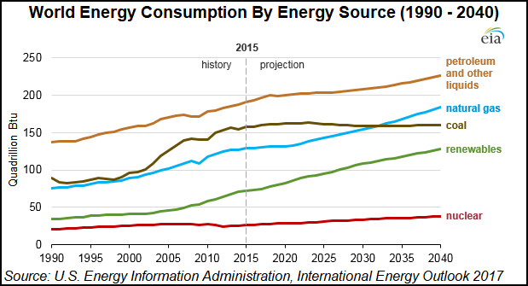
World Energy Consumption Profile between 1990 - 2040 by Source

Slide 15
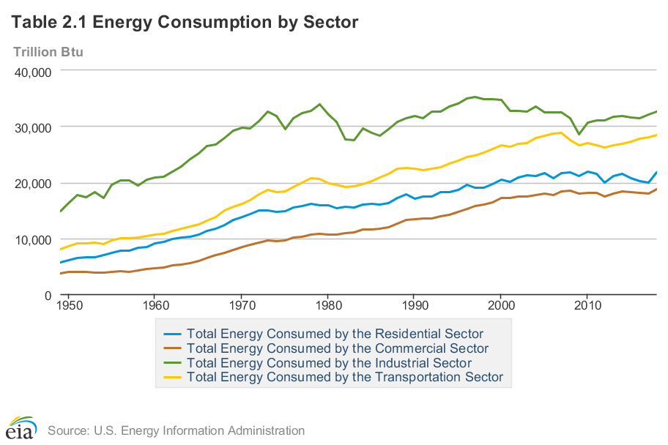
2017 World Energy Consumption by Sector

Slide 16
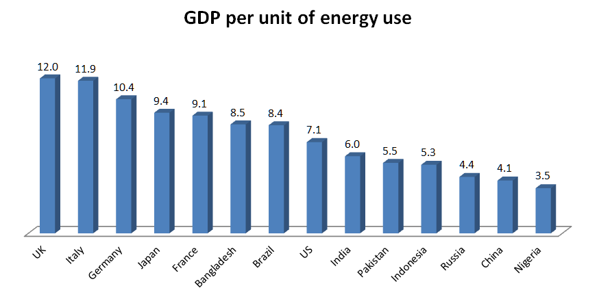
Energy Intensity For
A Selected Countries
Energy intensity is a measure of the energy efficiency of a nation's economy. It is calculated as units of energy per unit of GDP.

Slide 17
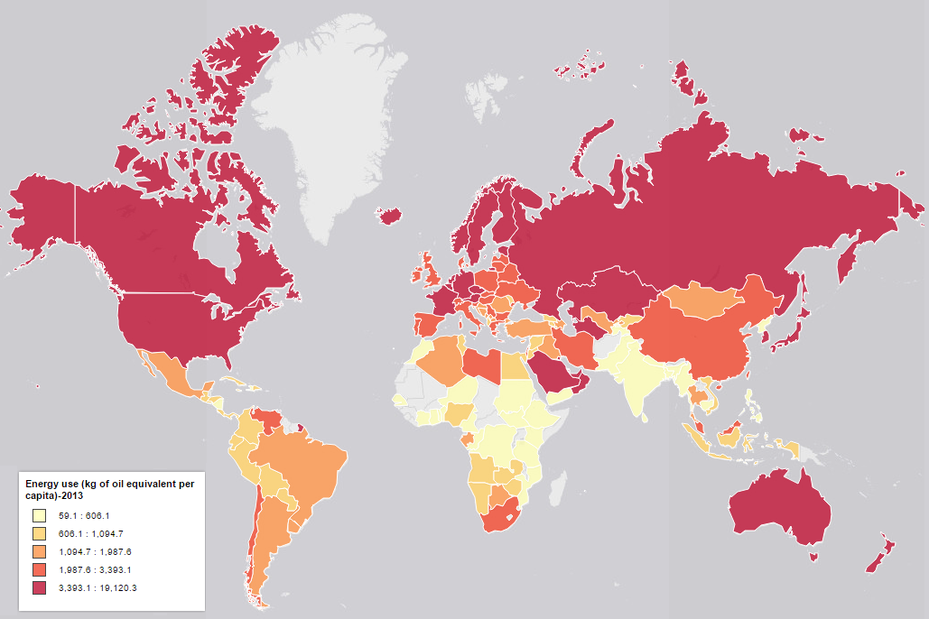
2013 Energy Use (Kg of Oil Equivalent per Capita)

Slide 18
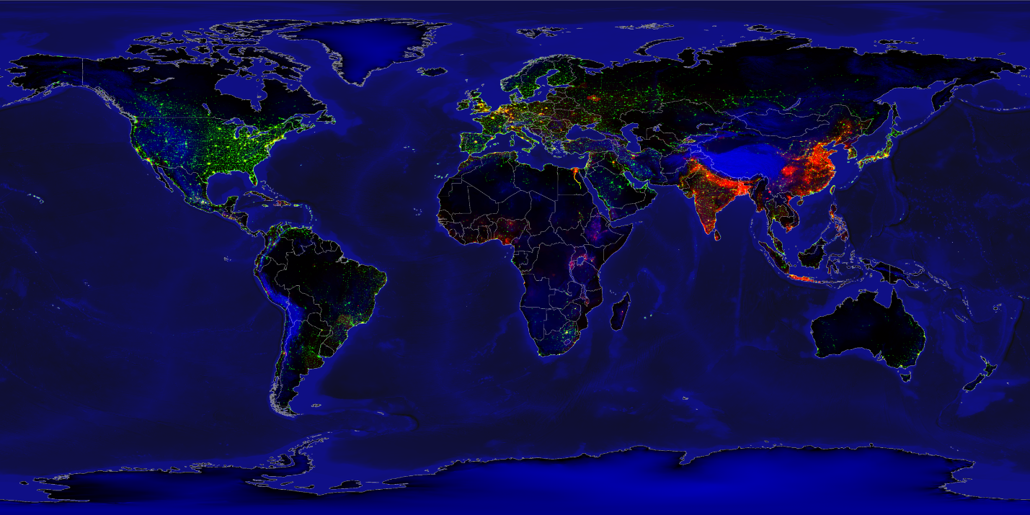
Equirectangular projection of Earth lights
Earth Lights (green channel) and population density (red channel) in 1994 showing disproportionate use of light between developed and developing countries, with topography and bathymetry (blue channel) as well as coastlines and country borders.

Slide 19

Converting one form of energy into another
Energy efficiency is the amount of useful energy obtained from a system. A perfectly energy-efficient machine would convert all of the energy put into the machine to useful work. In reality, converting one form of energy into another form of energy always involves a conversion into useable (or useful energy) and unusable (or un-useful) forms of energy.

Slide 20
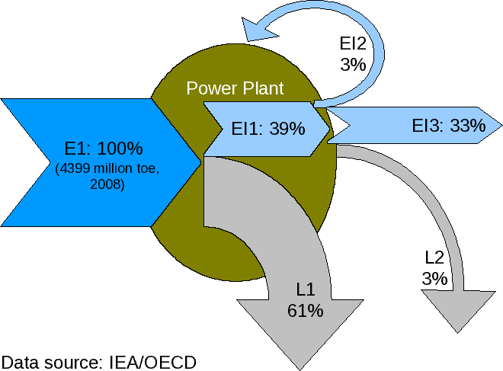
Converting one form of energy into another
(Continued)
Efficiency of power plants, world total, 2008
Energy flow of Power Plant, E1=Energy consumed, El1=Electricity generated, El2=Internal use, El3=Electricity for consumption, L1=Processing Loss, L2=Transmission Loss.

Slide 21
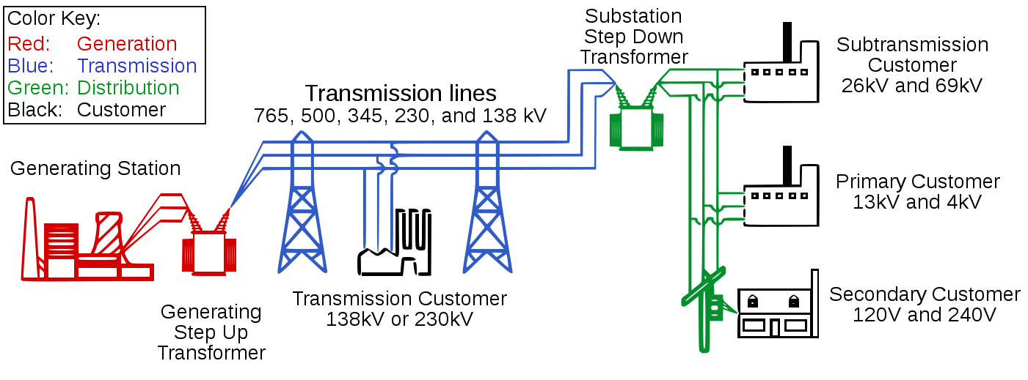
Considering the main parts of a typical Transmission & Distribution network, here are the average values of power losses at the different steps*:
1-2% – Step-up transformer from generator to Transmission line
2-4% – Transmission line
1-2% – Step-down transformer from Transmission line to Distribution network
4-6% – Distribution network transformers and cables
The overall losses between the power plant and consumers is then in the range between 8 and 15%.
This must not be mixed up with the efficiency of power plants like nuclear, coal-fired or natural gas turbine. These technologies are based on a thermodynamic cycle, which efficiency is in the order of 35%.
Converting one form of energy into another
(Continued)

Slide 22
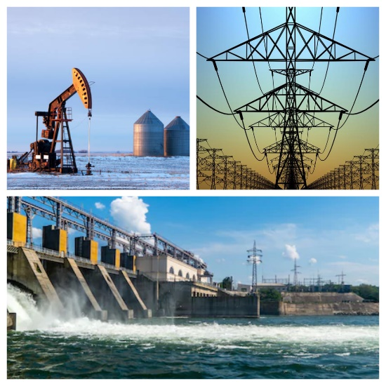
Estimated Energy Consumption in Afghanistan by Source
Today Afghanistan can partly provide itself with self-produced energy. The total production of all electric energy producing facilities is 1.22 bn kWh. That is 22% of the countries own usage. The rest of the needed energy is imported from foreign countries.
Energy source | total in Afghanistan | percentage in Afghanistan | percentage in Europe | per capita in Afghanistan | per capita in Europe
Fossil fuels | 0.15 bn kWh | 12.3 % | 58.9% | 42.4 kWh | 8,119.98 kWh
Water power | 1.03 bn kWh | 84.4 % | 23.4% includes nuclear | 289.88 kWh | 3,979.46 kWh
Renewable energy | 0.04 bn kWh | 3.3 % | 16.2% | 11.25 kWh | 3,276.27 kWh
Total production capacity | 1.22 bn kWh | 100,0% | 100% | 343.5 kWh | 15375.71 kWh

Slide 23
Source Type | Capital Cost $/kw | O&M $/Kw-yr
Wind | 1300-1450 | 39.7
Solar | 1800 | 23.4
Natural Gas | 1342 | 6.9
Coal | 3636 | 42.1
Hydro | 2813 | -
Estimated Electric Power Production Cost by Source

Slide 24
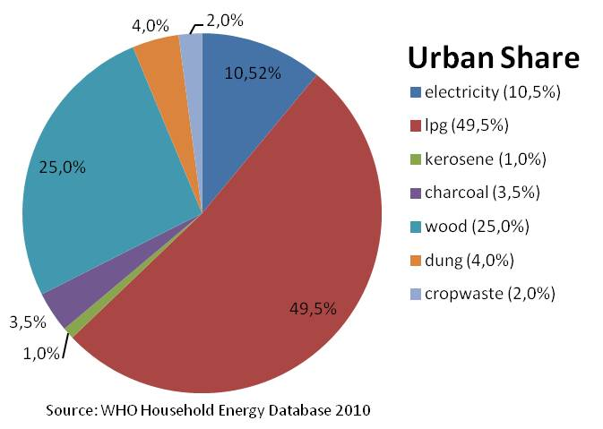
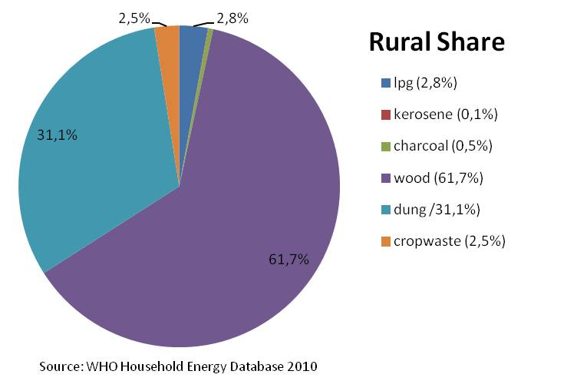
Estimated Energy Consumption in Afghanistan by Source

Slide 25
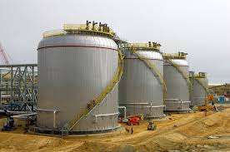
Afghanistan Energy Facts
Afghanistan is reported to have oil reserves totaling 2.9 billion barrels.
In 2014, nearly 97% of the country’s oil needs were imported.
The total installed generation capacity in Afghanistan is only about 520 MW, including 255 MW (49%) from hydropower resources; 200 MW (39%) from thermal sources (furnace oil, diesel, and gas); and 65 MW (12%) from distributed generators.
Imports constitute nearly 80% of the total power balance, and the import bill of energy has increased 14 times from $16 million in 2007 to nearly $224 million to 2015.
the total estimated undiscovered technically recoverable natural gas is 140 billion m³ in addition to already identified reserves of 75 billion m3. Natural consumption 146.6 m³ per year at this rate it will last more than 340 years (2015 estimate)

Slide 26
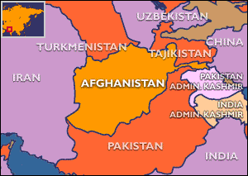
Afghanistan is located between two of the 2 largest natural gas rich countries of the world, namely Iran and Turkmenistan (number 2 and 4 respectively)
The latest find of natural gas reserve is in Turkmenistan known as Galkmysh which is about 100 km away from the Afghanistan border.
Electricity is monopolized by a semi-autonomous agency known as Da Afghanistan Brishnacoat Sherkat (DABS)
Afghanistan is among the lowest in electricity usage globally—about 150 kilowatt hours (kWh) per year per capita consumption—with only 30% of its population connected to the grid. Peak demand in 2014 was 750 megawatts (MW), although the unsuppressed demand is estimated at 2,500 MW.
In 2014, demand in major cities increased by almost 25%.
Electrification - urban areas: 84% (2016)
Electrification - rural areas: 78% (2016)
Afghanistan Energy Facts
(Continued)

Slide 27

What Can and Should Afghanistan Do Regarding its Energy Needs?
Modernity goes hand in hand with the advancement of “technology”. We define technology as any new idea, new approach, innovative equipment/machinery, and latest information/knowledge that are best fit in solving Afghanistan’s current energy problem must be explored. We cannot expect that what works elsewhere will work as efficiently and as effectively here.

Slide 28
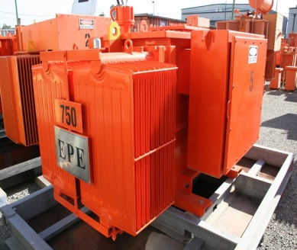
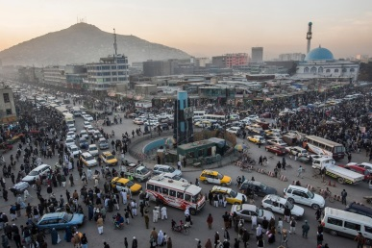

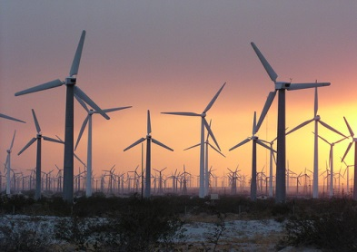
What Can and Should Afghanistan Do Regarding its Energy Needs?
Short-Term
Increase uses of the present generation capacity from 25%.
Reduce waste and pilferage through:
  Privatize power distribution (lease local power stations);
  Privatize power generation, make uses of the thousand generators available throughout the country (purchase power from small generators at the distribution point);
  Reduce mechanical waste (replace older transformers, meters, and cables).
Install renewable generating capacity such as wind mills for a quick increase in capacity and actual power generation.
Start using CNG for power generation, transportation, and other application.
Regulate the use of higher efficiency products such as LED.

Slide 29
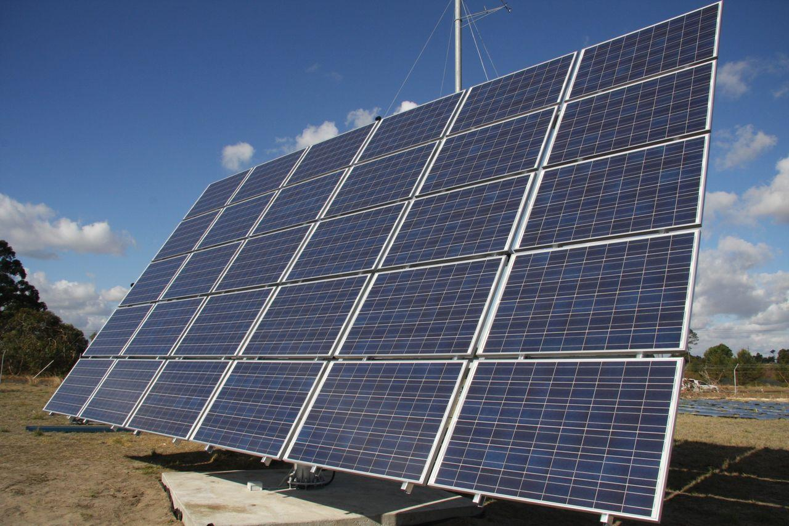
Example of Short-Term Solution
Solar Energy
Solar energy is lauded as an inexhaustible fuel source that is pollution- and often noise-free.
solar energy use has surged at about 20 percent a year over the past 15 years, thanks to rapidly falling prices and gains in efficiency.
Afghanistan has the potential to produce over 222,000 MW of electricity by using solar panels.
Solar energy can be harnessed by a single family home as well as in large solar farms.
Energy
29

Slide 30
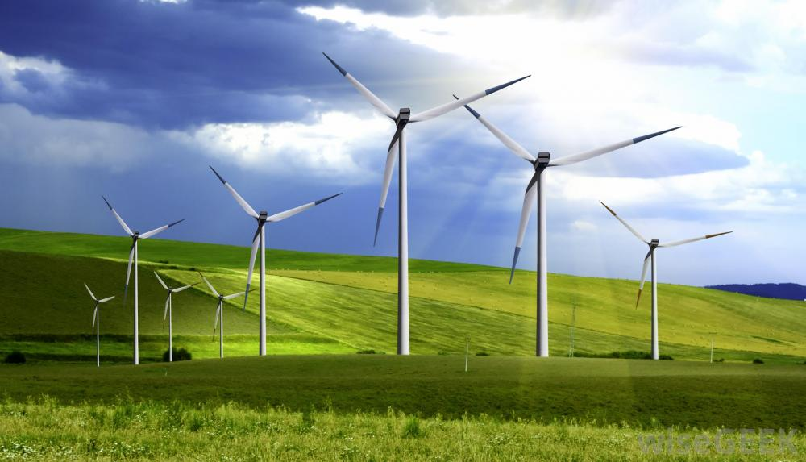
Example of Short-Term Solution
(Continued)
Wind Energy
Wind power is cost-effective. Land-based utility-scale wind is one of the lowest-priced energy sources.
It's a clean fuel source. Wind energy doesn't pollute the air like power plants that rely on combustion of fossil fuels, such as coal or natural gas,
United States Agency for International Development has teamed up with the United States National Renewable Energy Laboratory to develop a wind map of Herat province. They have identified approximately 158,000 megawatts of untapped potential wind energy. Installing wind turbine farms in Herat could provide electricity to much of western Afghanistan.
Wind energy can be harnessed in small application such as a single family home as well as in large wind farms.
Energy
30

Slide 31
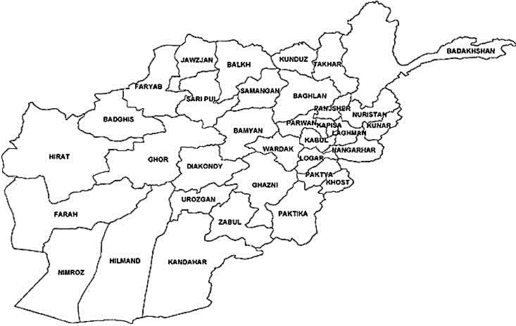
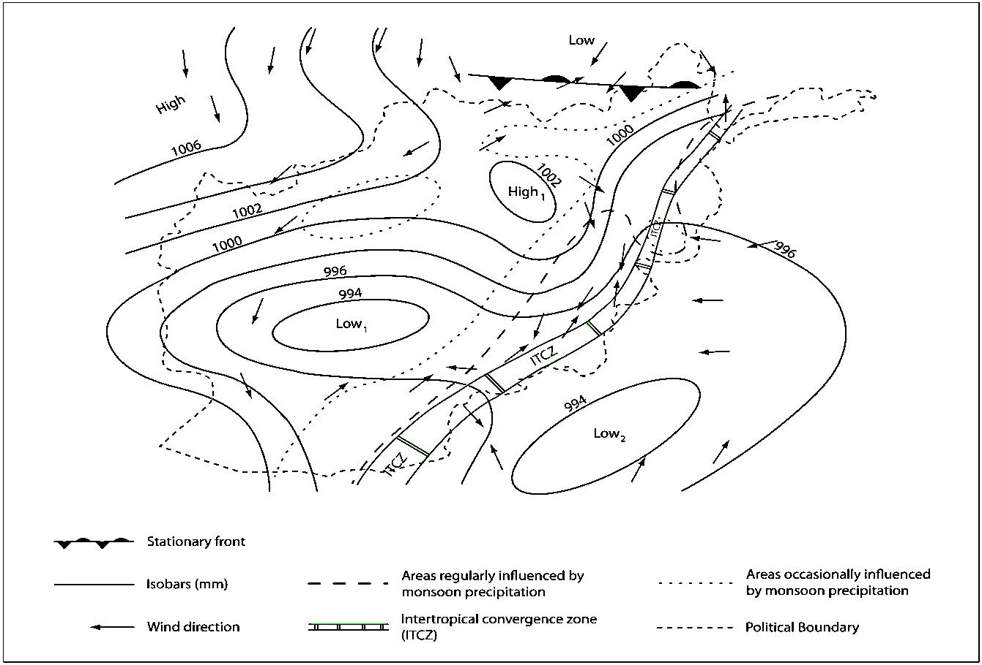


Wind Intensity Locations in Afghanistan
Energy
31

Slide 32

Traffic Light
Short-Term
Solar powered traffic lights can be used in temporary settings where a traffic signal is only needed for a set period of time.
Solar powered traffic lights and widespread around the world. They easily deployed, energy efficient, good for the environment, and require minimum maintenance.
solar power traffic light is no cabling and higher level of security than traditional traffic lights.
In Large cities such as Kabul help to reduce traffic congestion, save energy, and improve air quality.
Energy
32

Slide 33
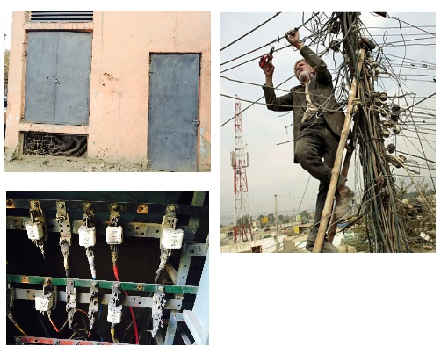
Example of Short-Term Solution
(Continued)
Leasing Power Substations
Waste and pilferage are some of the most common inefficiencies in the distribution of electrical power. One simple reform that would go a long way toward reducing these inefficiencies would be to allow private operators to run and maintain the many neighborhood substations in every town and city.

Slide 34
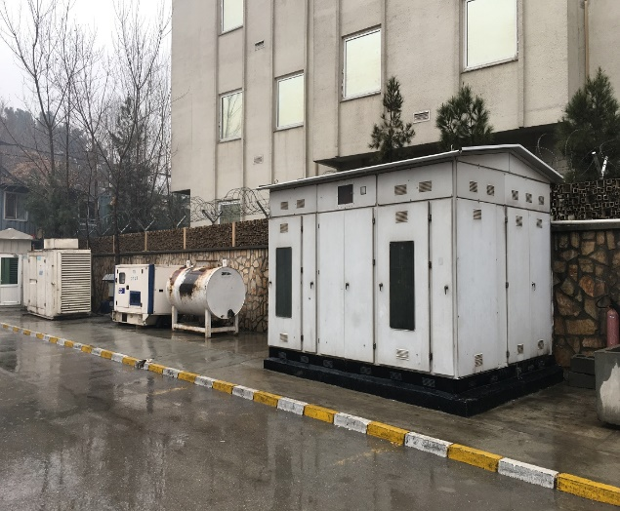
Example of Short-Term Solution
(Continued)
Micro/Nano Grid
Purchasing power from private generators makes a great economic sense. The initial investment in the generation segment of the overall power supply chain has already been made by the many generators that are available in Afghanistan today. Operating with an eye on profitability forces great efficiency in the overall system.

Slide 35
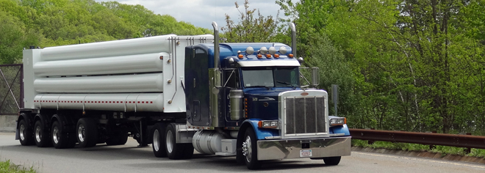
Example of Short-Term Solution
(Continued)
The Case for Compressed Natural Gas (CNG)
In the world today, natural gas is transported three ways: by pipeline, liquefied, and compressed.
CNG is the best replacement for diesel, petrol, and LPG.
CNG is used in the world in transportation, heating, electrification and others.
The same can be done here.
Production: 164.2 million cu m (2017 est.)
country comparison to the world: 79
consumption: 164.2 million cu m (2017 est.)
country comparison to the world: 108
Proven Reserves: 49.55 billion cu m (1 January 2018 est.)
country comparison to the world: 62 and at this rate it will takes us more than 300 years to deplete the proven reserves.

Slide 36
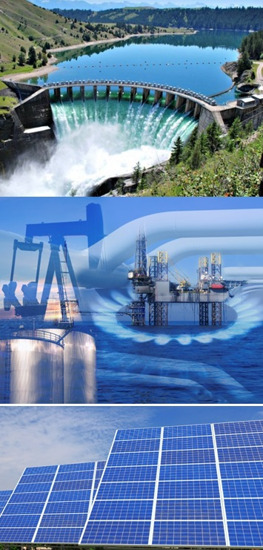
Long-Term Solution
Long-Term Solutions (2 years and more)
Learn electricity demand for cities and rural areas by maintaining a comprehensive data base of 24 hour, seasonal, and yearly cycles.
Complete privatization of power generation, transmission and distribution industries.
Increase uses of natural gas for power generation, transportation, and home heating and cooling as well as reducing imported petroleum.
Large renewable energy farms (wind and solar)
Sign more favorable contracts with exporting countries based

Slide 37
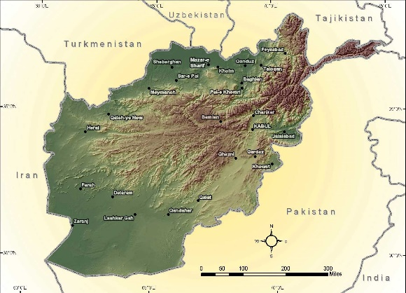
Conclusion
Afghanistan is an energy rich country. It has the potential not only to fulfil its own needs but to export energy to other countries as well.

